Slide 1
Magento
Part 1: Basics

Slide 2
What is E-commerce?
E-commerce (Electronic Commerce) is a type of business that involves the commercial transaction or purchasing or selling of goods and services through electronic channels known as internet. It was first introduced in the year 1960 through EDI (Electronic Data Interchange) on VAN (Value-added network). Using E-commerce, you can sell physical products or services (where the payment is made online).
Following are the categories of E-commerce:
B2B (Business to Business): This transaction is between businesses. It is between the wholesaler and the retailer or between the manufacturer and the wholesaler.
B2C (Business to Consumer): This transaction is between businesses and consumers. In this type of transaction, merchants sell products to consumers through shopping cart software.
C2C (Consumer to Consumer): In this type of transaction, one consumer or customer interacts with other consumers through internet.

Slide 3
What is Magento?
C2B (Consumer to Business): This transaction is between the consumer or the customer and businesses or organizations where the consumer makes a product that the organization uses it to complete the business.
Magento is an open source E-commerce software, created by Varien Inc., which is useful for online business.
It has a flexible modular architecture. It is scalable and it has many control options that helps the user to build both user-friendly and search engine friendly websites.
Magento uses E-commerce platform which offers companies the ultimate E-commerce solutions and extensive support network.
Magento allows user to update E-commerce website automatically. It is simple, quick and versatile to use.
Magento was first released on March 31, 2008.

Slide 4
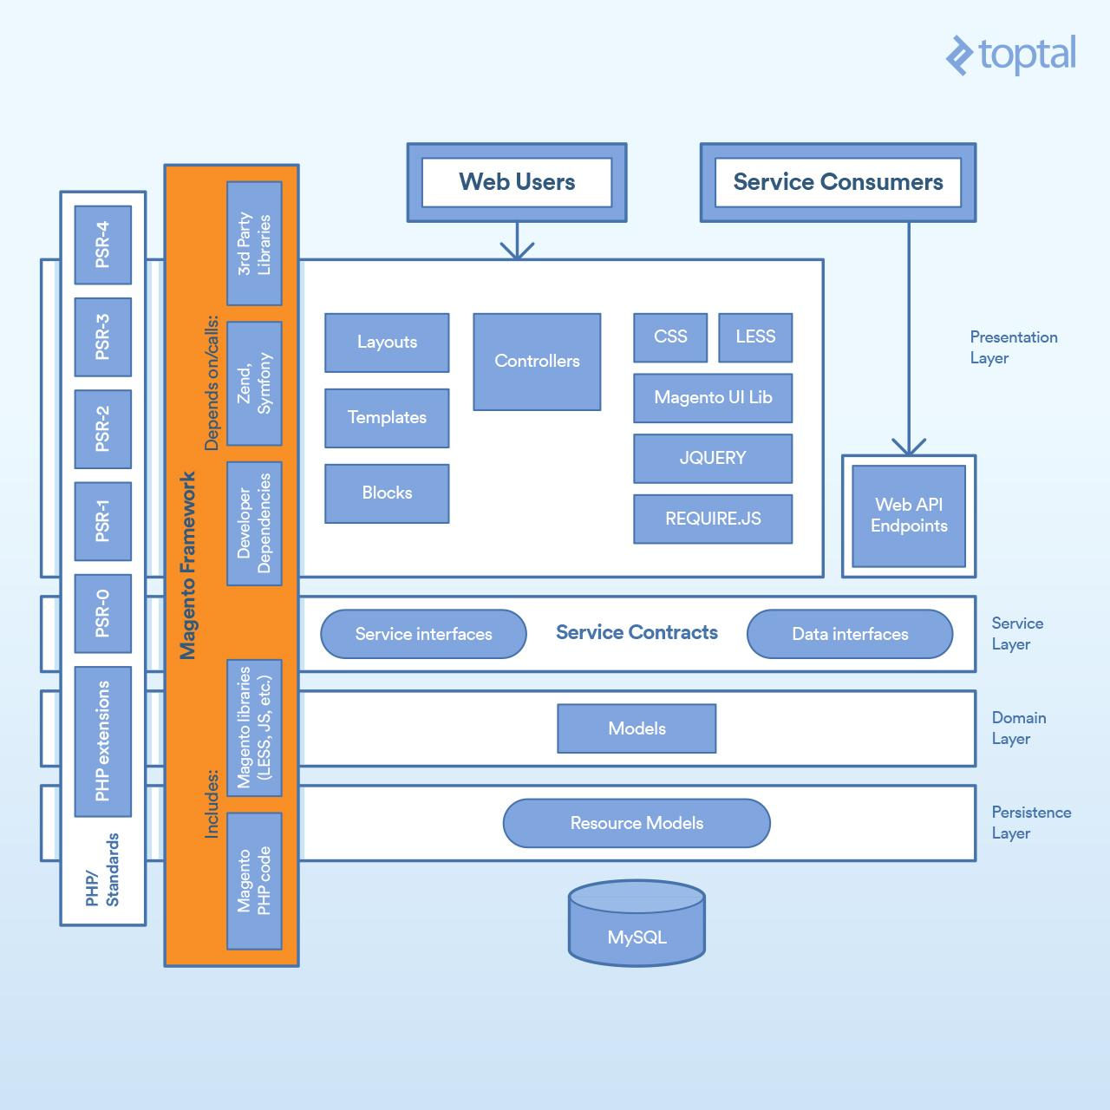

Slide 5
Why to Use Magento?
Magento is an open source E-commerce software.
Magento is scalable and offers small organizations to build business.
Magento enables searching and sorting of products in several ways.
Magento easily integrates with many of the third-party sites which are needed to run effective E-commerce website.

Slide 6
Features
Magento provides different payment methods such as credit cards, PayPal, cheques, money order, Google checkouts, etc.
Magento enables shipping of products in one order to multiple addresses.
Magento helps to manage the orders easily by using the admin panel.
Magento provides order of product status and history of product. It also supports e-mail and RSS feeds.
Magento supports multiple languages, different currencies and tax rates.
Magento filters the products and displays in grid or list format.
Magento makes it easy to browse the products. It has features such as image zoom-in and checking of stock availability.
Magento has built-in SEO (Search Engine Optimization).

Slide 7
Advantages
Magento is user friendly E-commerce software.
Magento is compatible with smartphones, tablets and other mobile devices.
Magento provides multiple payment options, so every visitor can make payment based on their preferred payment gateway.
Magento has many extensions which support the development of an online store.
Disadvantages
Magento uses larger disk space and memory.
Magento takes longer time to build the customized functionality.
Magento is very slow compared to other E-commerce sites.
Magento needs proper hosting environment. If the hosting environment is
improper, the user can face many problems.

Slide 8
System Requirements for Magento
Database: MySQL 5.1+
Web Server: Apache 2.x, Nginx 1.7.x
Operating System: Cross-platform
Browser Support: IE (Internet Explorer 7), Firefox, Google chrome
SSL (Secure Socket Layer): A valid security certificate is required for HTTPS
PHP Compatibility: PHP 5.4

Slide 9
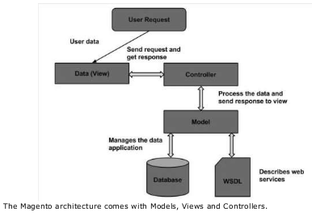
Magento ─ Architecture

Slide 10
Architecture
The Magento architecture comes with Models, Views and Controllers.
User Request: The user sends a request to a server in the form of request message where web browsers, search engines, etc. act like clients.
View: View represents the data in particular format. It is the user interface which is responsible for displaying the response for user request. It specifies an idea behind the presentation of the model's data to the user. Views are used to reflect "how your data should look like".
Controller: The controller is responsible for responding to user input and perform interactions on the data model objects. It uses models to process the data and send responses back to the view.
Model: The model is responsible for managing the data of the application. It contains logic of the data and represents basic data object in the framework. It responds to request from the view and to the instructions from the controller to update itself.
Database: Database contains the information which is requested from the user. When the user requests data, view sends requests to the controller, the controllerrequests from the model and the model fetches the required information from the database and responds to the user.
WSDL: WSDL stands for Web Services Description Language. It is used for describing web services and how to access them.

Slide 11
Part 2: Store Setup
Magento Products
Products are the items or things that are sold in Magento. Product can be anything that is capable of satisfying the customer’s needs. This includes both physical products and services.
Simple Products
Grouped Products
Configurable Products
Virtual Products
Bundled Products
Downloadable Products

Slide 12
Simple Products: These are general product type, which are the most used products. In this section, there are no options for selecting size or color of the product.
Example: Coffee cup, DVD's,Camera lens, etc.
Grouped Products:This is a group of simple products. In this type, you cannot specify a specific price for a product; you can just specify the discount.
Example: Cell phone + Memory card + Earphone
Configurable Products:In this type, customers can select products according to their color and size before purchasing.
Example: Cell phones obtained in different colors and sizes.
Virtual Products:Virtual products are those which do not have physical counterpart, i.e. these are used forvirtual items. These products cannot be shipped or stocked.
Example: Online training courses.

Slide 13
Bundled Products: Bundled products are those products which cannot be sold separately and doesn't give anychoice to the end user.
Example: Consider you want to buy a cell phone which includes earphone, memory card, battery, charging cable, etc. These are together called bundled products. These products cannot be sold individually but can be sold within the bundle product.
Downloadable Products: Products which are available for download are known as downloadable products.

Slide 14
Product Attributes
Attribute describes the property of the product.
Product attributes helps to set product properties such as color, size width, height, etc. and makes the product unique.
Add as many attributes to your product as required.
The following steps describe, how to set up the attributes for products in Magento:

Slide 15
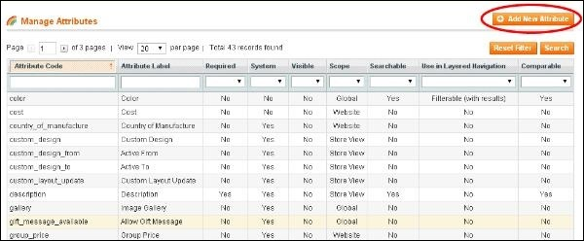
Step (1): Login to your Magento Admin Panel.
Step (2): Go to Product -> Catalog and select Attributes from the dropdown menu and click on the Manage Attributes option.
Step (3): Under Manage Attributes section, you will find different attributes used in the system. For adding new attribute, click on Add New Attribute seen on the top right corner of the screen.

Slide 16
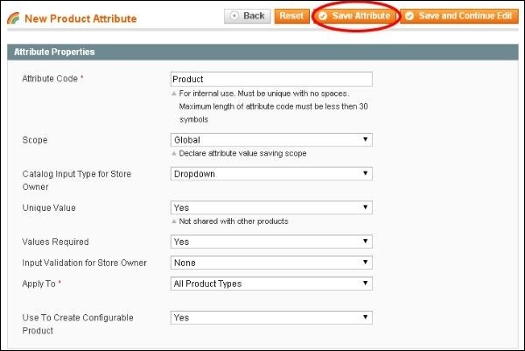
Step (4) − Now you need to set the attribute properties for your product. After setting up all the required attribute properties, click on Save Attribute button to store the product information.

Slide 18
WEBSITES AND STORES
Magento supports the creation and management of multiple stores in a single Magento installation, Magento has a hierarchy of concepts that define the relationship between the individual stores in a Magento installation.
In Magento, a website is a collection of stores, which themselves are collections of store views.
These layers, although perhaps initially confusing, provide you with powerful flexibility when setting up online businesses in Magento.

Slide 19
A website is made up of one or more stores which share the same customer information, order information and shoppi ng cart.
Stores are collections of store views and can be setup in a variety of ways. Their main function is to provide a logical container that allows you to group related store views together in a website.
Store Views are the actual store instances in Magento. Most stores will have a single store view associated with them. But a store can also have multiple store views, which are typically used for different languages.
Therefore, if you wanted to have a store displayed in English and Spanish
For example, you could create the store once and create two different store views for that store.

Slide 20
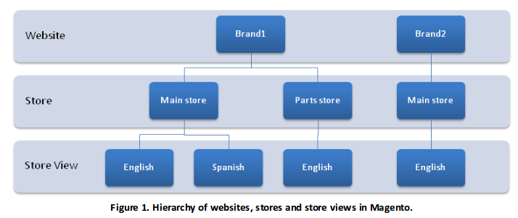
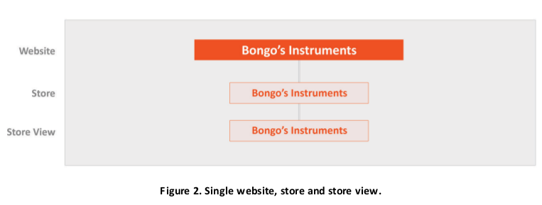
SCENARIO 1—ONE STORE

Slide 21
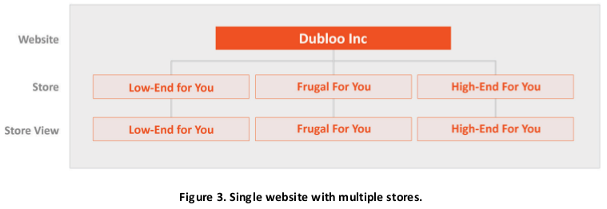
SCENARIO 2 —MULTIPLE R ELATED STORES
“Dubloo” creates an online presence with three separate clothing stores that each cater to a different price-level audience.

Slide 22
SCENARIO 3—MULTIPLE INDEPENDENT STORES
A company named “My Laptops” wants an online presence with two separate stores that both sell laptops but at different prices and with different product selections in some categories.
They also want to offer English and Spanish language options per store. Within each store they need to synchronize customer and order information, but they do not need to share this information between the two stores.
In this scenario,My Laptops would have two websites (which stops customer and order info from being shared with stores in the other website), each with one store and two store views (one for English and one for Spanish).

Slide 23
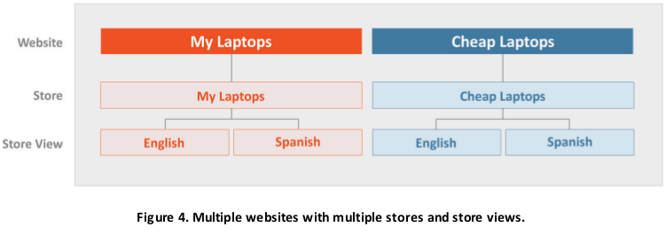

Slide 24
http://magento2-demo.nexcess.net/
https://www.mageplaza.com/kb/magento-2-demo.html

